Slide 1
OceanSITES: New Perspectives
Nathan Anderson

Slide 2
Overview
Summary of the Documentation
Data Providers’ Guide*
How to participate in OceanSITES (recently posted*)
Data Format Reference Manual (was User’s Guide)
Data Users’ Guide (coming soon*)
Open source tools for access and use (example Matlab/Python scripts), GitHub
What would make the OceanSITES DMT more effective?
New Users: Getting Started*
* Combine Documents into Checklist?

Slide 3
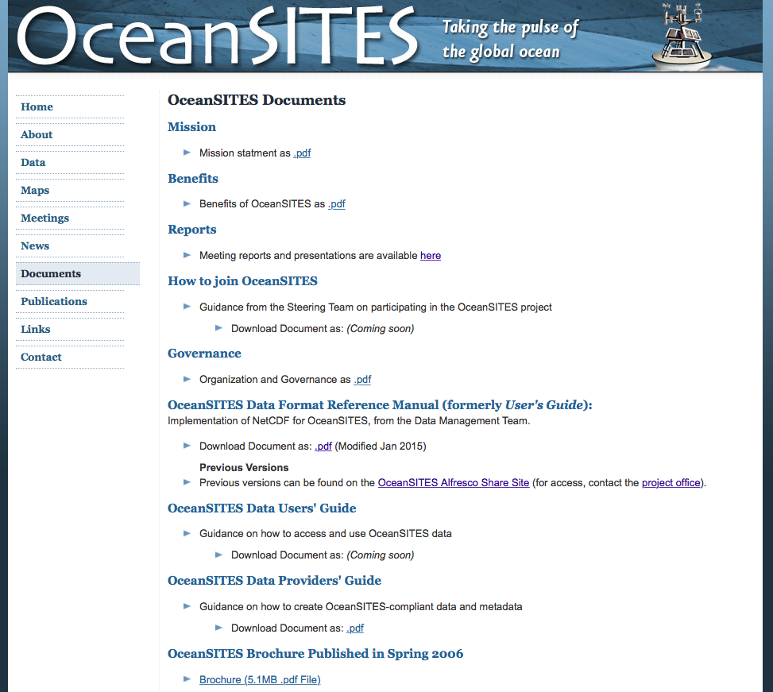
Data Provider’s Guide
Guides user’s Data Management
Mission Statement and Documentation Summary
Users provide “Best” data
Data flow clearly defined
(PI -> DAC -> GDAC)
Registration
Mentions contacting OceanSITES: Who to contact? Who’s associated with the OceanSITES catalog? Automate registration?
How to register with the GDACs?
Incorporate checklists for making, checking and loading OS files (including how to ftp and load files)

Slide 4
Data Format Reference Manual
The quintessential OceanSITES document
Complete description of OceanSITES compliance in creating NetCDF files
Extensively covers dimensions, variables, coordinate variables, attributes (metadata) and naming conventions
Assumes pre-existing knowledge of NetCDF
Complex to newcomers, mainly because it lacks instructions on how to make NetCDF files

Slide 5
Intro to NetCDF
How many people read/write NetCDFs?
How many use format checker, or CF checker?
Creating OceanSITES compliant files can be difficult, but doesn’t have to be.
New users benefit from templates
Scripts can guide file creation and NetCDF interaction
Consider making an OceanSITES website folder containing NetCDF reading and writing tools in many languages (to start: Python, Matlab)
Provide feedback to the user about compliance issues and/or continue improving the format control and checking tools for users.

Slide 6
File Sharing
GitHub is a useful file exchange platform for open source projects (“social media for file sharing”)
Private or public accounts available; users/partners maintain control of their own repository, but public suggestions can be incorporated
Questions about writing code frequently appear and are answered on GitHub forums

Slide 7
Summary
Simplify for new users (GitHub, OceanSITES file exchange folder, etc.)
Encourage feedback on compliance, even for the experienced programmers
Provide concise and consolidated documentation
Write documents “step-by-step” (checklists) to guide users into OceanSITES methods

